Slide 1
Rideshare Application
External
Internal
Optimizer
Rideshare Database
Control
Internet
User Interface
Google Geocoder
Google Maps
Users
Internet

Slide 2
Optimizer
Control
Rideshare Requests
Problem Reduction
Ride Offers
User Criteria
Geographic Criteria
Ride Requests
Matching Algorithm
Iterative
Bipartite Matching
Genetic Algorithm
Brute Force
Optimized
Results
Google Maps
Match Evaluator

Slide 3
Control
Rideshare Database
Optimizer Control
Database Interaction
Optimizer
Internet Request Queue
Google Geocoder
Google Maps

Slide 4
User Interface
Web toolkits
Session Manager
Google Maps
Interactive Map
Framework
Web Pages
Google Geocoder
Optimized
Results
Rideshare Requests
User Profile Data
Ride Offers
Ride Requests

Slide 5
FIXME - Update this slide
Rideshare Database
Possible Rideshare Matchings
User Profile Data
Optimized
Results
User History Data
Set 1
D
R
Site Statistical Data
Rideshare Requests
Ride Offers
Secure Sessions
Data
Set N
Ride Requests
D
R
User Interface
Optimizer
Secure Session Manager

Slide 6
Login Page
Rideshare
Welcome to Rideshare
Please log in to your account:
Email Address
Password
What is Rideshare?
Don’t have an account?
Click here to register.

Slide 7
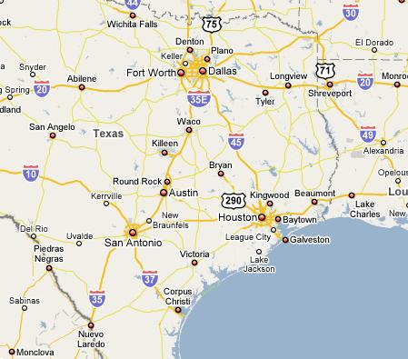
Ride Request Page
New
Ride Request
Origin/destination
origin
destination
Time window
latest departure
latest arrival
Confirm
Advanced Options

Slide 8
Ride Request Page - Rider
New
Ride Request
Riding
Driving
Origin/destination
origin
destination
Time window
date
earliest departure
latest arrival
Confirm
Advanced Options

Slide 9
Ride Request Page - Rider
My Rides
My Profile
New Ride
My Friends
Main Page
New Ride
Riding
Driving
Origin/destination
origin
destination
Time window
date
earliest departure
latest arrival
Confirm
Advanced Options
Gender preference
Age preference
Driver Options
Rating
Maximum Passengers

Slide 10
New Route
My Rides
My Profile
New Ride
My Friends
Main Page
New Route
Route Details
Time Window*
Start Location
End Location
(Check One)
I need a ride
I am driving
Confirm
Advanced Options
Notes:
Is time window arriving or leaving?? Do we need a separate new route page for both

Slide 11
New Route (Advanced Options)
My Rides
My Profile
New Ride
My Friends
Main Page
New Route
Route Details
Time Window*
Start Location
End Location
(Check One)
I need a ride
I am driving
Confirm
Advanced Options
Notes:
Is time window arriving or leaving?? Do we need a separate new route page for both

Slide 12
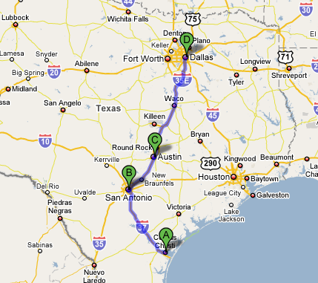
Confirmation Request Page
Confirm Passenger
Passenger Details
Name, Rating
Pickup Location/Time
Drop off Location/Time
My Route Details
Start Location/Time
End Location/Time
Confirm
Reject

